Slide 1
Inside and Out of Transactional Replication
Chuck Lathrope (@SQLGuyChuck
Email: sqlguychuck@gmail.com
Code: https://github.com/SQLGuyChuck
http://www.sqlsaturday.com/511/sessions/sessionevaluation.aspx

Slide 2
What is an affordable, customizable, native feature set for horizontally scaling SQL Server?
SQL Server Transactional Replication

Slide 3
Why Transactional Replication and not…?
Always-on – Enterprise only feature $$$, limited copies and not customizable = limited scalability
Database Mirroring – On deprecation list (for Always-on), limited copies = limited scalability
Log shipping – Read-only yes, but only in-between updates
Service broker – Requires a lot of coding and potential re-write of your application
Clustering – clustering provides high availability of SQL Engine, no data duplication
3rd party applications – Not free, some are new to industry, unlike replication - been around forever.
Notes:
You could scale vertically and do it all on one server, even with multiple instances and run on a cluster, but let’s assume you have already done that.

Slide 4
A little about me, Chuck Lathrope
26 years in IT, mainly supporting Microsoft products
Past 14 years have been in SQL Development and Database Administration.
Published author on replication in TribalSQL by Redgate.
Top 5 finalist for Exceptional DBA award 2009.
I was the Database Operations Manager for eNom who’s infrastructure supported 13 publication servers, with over 60 subscribers throughout U.S.

Slide 5
What I Will Cover Today
Concepts and definitions
Replication Setup Walkthrough
Performance tuning
Monitoring replication
Bonus 1: Troubleshooting replication
Bonus 2: Code deployment tips
Notes:
This talk will enable you to start your own proof of concept with replication.
?’s for Audience: How many have little knowledge and are here to learn more? How many are thinking about using it but haven’t yet? How many people have replication in their environment? How many people know why they have replication?

Slide 6

Section 1: Concepts and Definitions
Photo Credit:
https://www.flickr.com/photos/mukumbura/2427389787

Slide 7
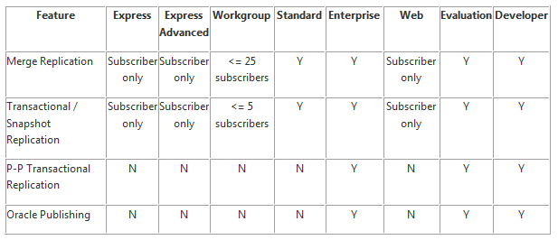
SQL Edition Capability Map

Slide 8
Replication Definitions
Replication is the process of sharing data between databases and ensuring the data is transactionally consistent between systems.
Replication components are defined using a publishing industry metaphor.

Slide 9
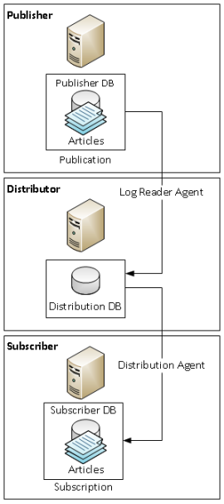
Publishing Industry Metaphor Concepts
Publisher is the source server that has a published database
Publication is a set of articles to be published as one group
1 db per publication, but publisher can have many publications.
Article is an object that can be replicated.
Distributor is a server that distributes the publication data to subscriber servers or clients.
Subscriber subscribes to the publication and this is called a subscription.
A subscriber can subscribe to many publishers and publications as long as the articles data are non-overlapping.

Slide 10
What Can Be Replicated?
Tables
Stored Procedures (Definition & Execution)
User Defined Functions (Definition)
Views (Definition)
Indexed Views (Definition)
Indexed Views (As Table)
DDL Commands

Slide 11
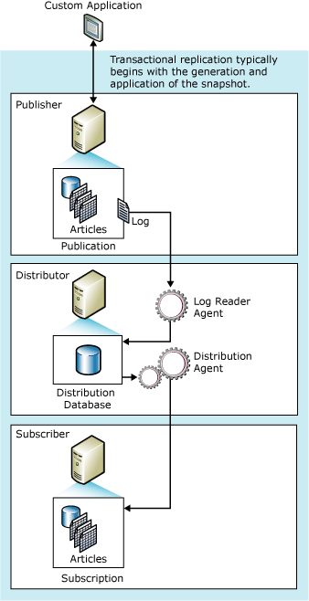
How Replication Works
A snapshot is the process to initialize the dataset for the subscribers. It can be a backup, but more often a bcp process that is automated for you.
Agents are exe programs that automate the process. You rarely ever need to know they exist.
Log reader agent reads transactions marked as replicated in log file and puts the data into Distribution database.
Distribution agent pushes or pulls the data into the subscriber database.
Notes:
The picture denotes a default push subscription model as the distribution agent lives on distributor. In a pull subscription model, the agent will be on the subscriber. If you have >5 subscribers, you should think about moving a pull model to offload some of the work onto the subscribers.

Slide 12
Replication Use Cases
Server to Client data replication
Exchanging data with mobile users
Consumer point of sale (POS) applications
Integrating data from multiple sites (regional office locations)
Horizontally scaling SQL Server
Improving scalability and availability (offload work)
Data warehousing and reporting
Integrating data from multiple sites
Integrating heterogeneous data (Oracle, etc.)
Offloading batch processing
Notes:
What good is replication for anyways?

Slide 13
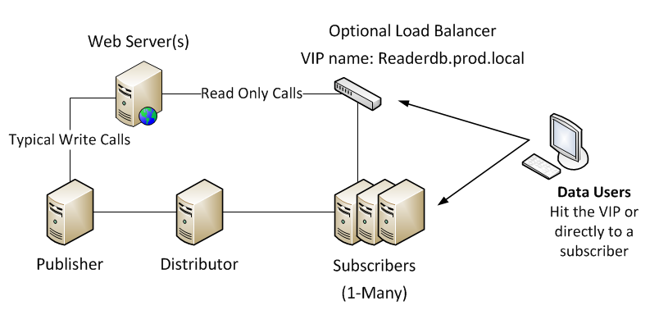
Typical Transactional Replication Use Case

Slide 14
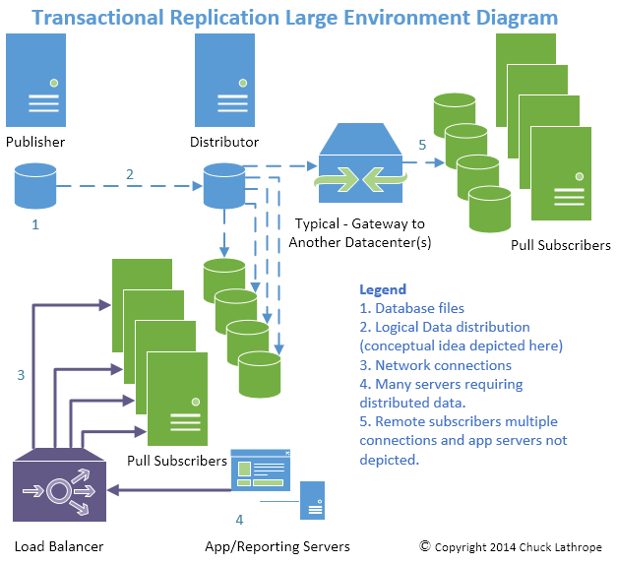
Notes:
Every connection has a parameter that can be tweaked. You could even turn on jumbo frames for LAN high speed connections.

Slide 15
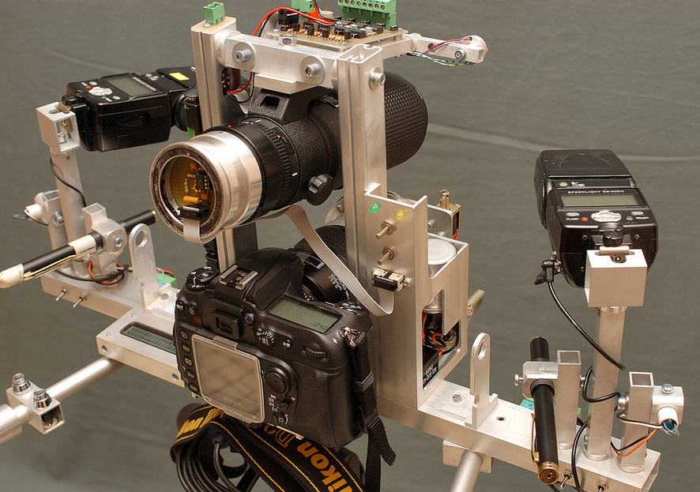
Section 2: Replication Setup Walkthrough
Photo Credit:
https://www.flickr.com/photos/fotoopa_hs/3103154432

Slide 16
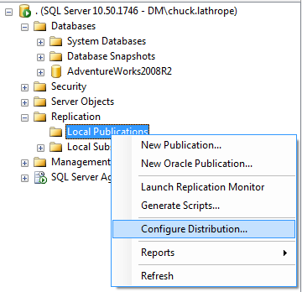
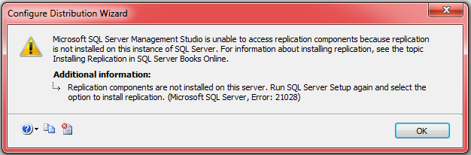
Using SSMS to Configure Distribution
In SQL 2008 + you have to install replication components. (Add/Remove Programs for SQL Server and select Add.)
Otherwise you get an error:

Slide 17
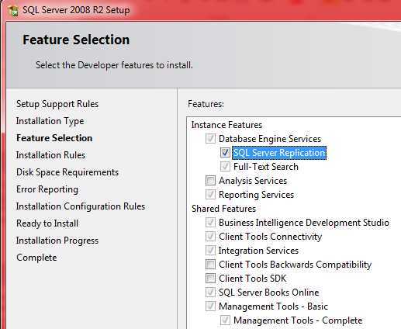
Adding Replication Component
Make sure to select the SQL Server Replication Feature.

Slide 18
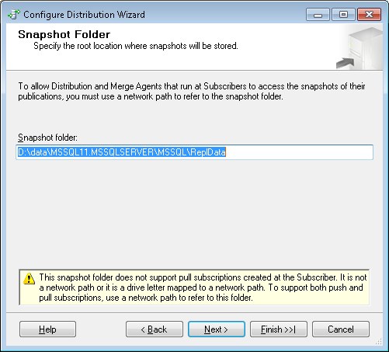
Distribution Snapshot Folder Setup
Default is local folder
Change to a share with read permissions from subscriber, write from distributor agent account.
\\distribserver\Repldata

Slide 19
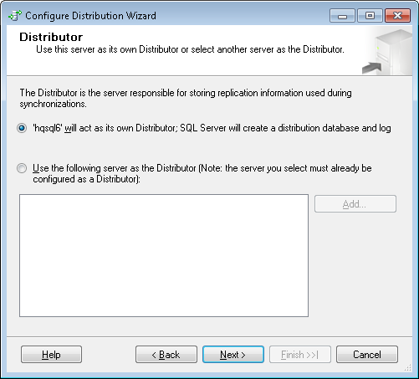
Distributor Setup
For small environments Publisher and Distributor can be the same server.
It will create a DB called Distribution
Optimize file size after creation

Slide 20
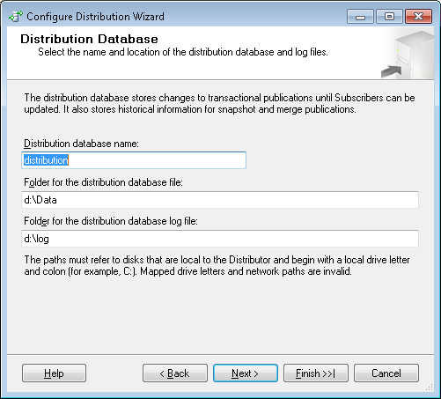
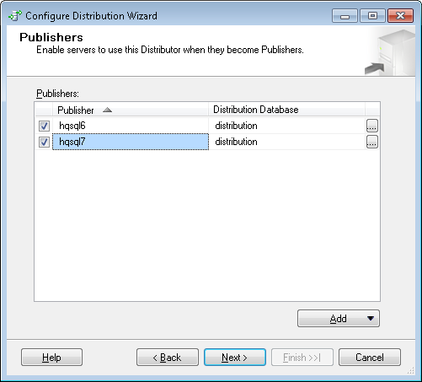
Next Steps on Distributor Setup
If using AlwaysOn or multiple publishers, you add in dialog now, or tsql later.

Slide 21
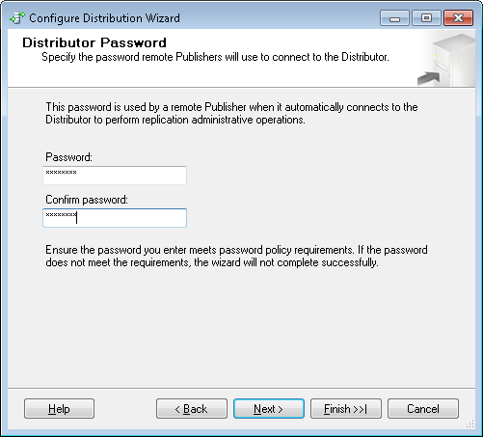
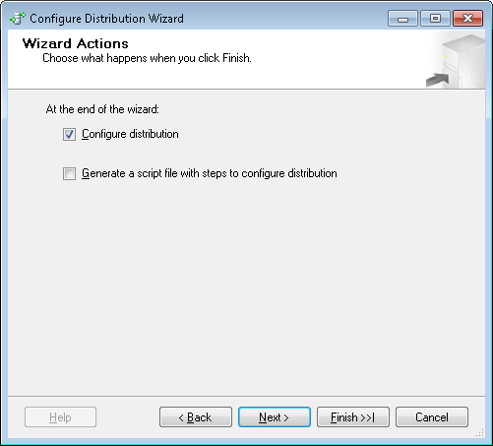
Finalizing Distribution Server Setup
Create a password for distributor (subscriber setup will use it.
Next until complete. Script out if curious.

Slide 22
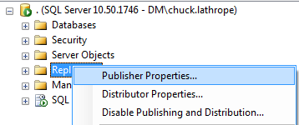
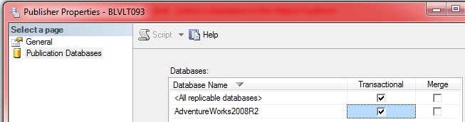
Enable Publications
You must enable your database to be a publisher.

Slide 23
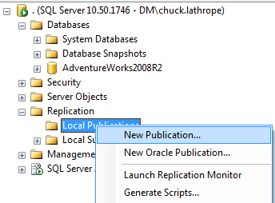
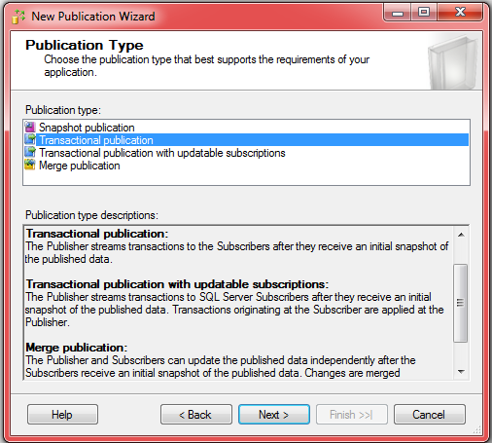
Create a Publication

Slide 24
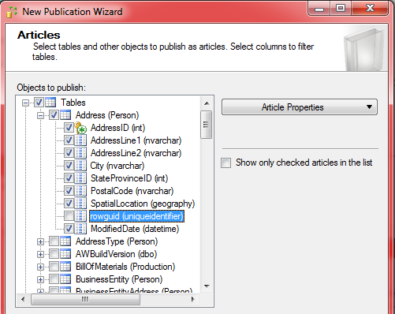
Articles – be selective choose needed columns
Be picky about what data you want on the subscribers.

Slide 25
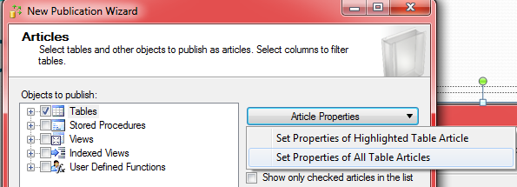
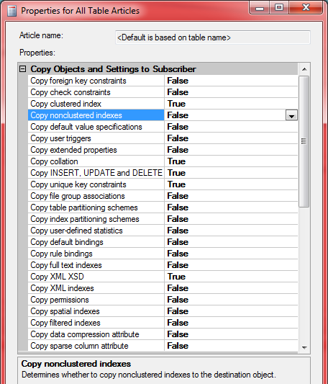
Customizing Replication Settings
Change options to your preferences, like copying non-clustered indexes or permissions.
You can use post snapshot deployment scripts to customize your indexing on a server by server basis using t-sql and @@servername checks.

Slide 26
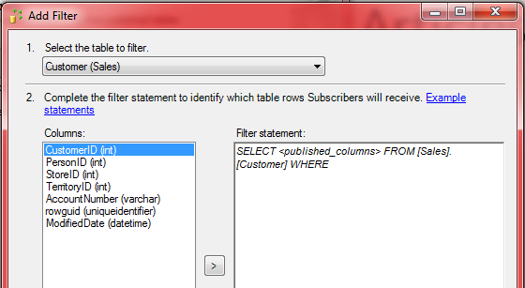
Add Table Row Filters
Filter data e.g. where StoreID=100.
Warning: don’t get complex as this is evaluated for every row.

Slide 27
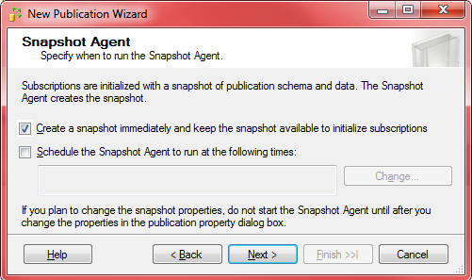
Select Snapshot Agent Properties
Warning! Hidden selection in this dialog window.
Immediate Sync is on when first option is selected.
Immediate Sync keeps snapshots useable for retention period (default 48 hours)
For high replication transaction env. this could bloat distribution db size.
Can toggle it on/off with exec sp_changepublication @publication='AdvWorks2012', @property='immediate_sync', @value='FALSE'

Slide 28
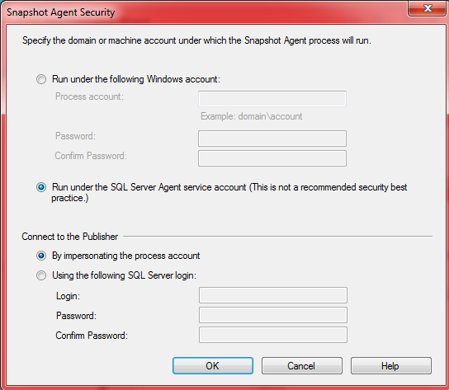
Select Security Method for Snapshot Agent
The snapshot agent is responsible for moving data from the publication db to the snapshot folder as well as to distribution db. So, it needs write ability on snapshot folder and db_owner on both publication db and distribution db.
Notes:
The last screen is what you want to call the publication.

Slide 29
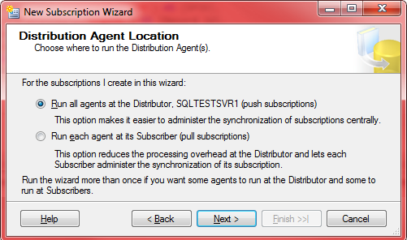
Add a Subscriber
Start the New Subscription Wizard on subscriber (SSMS Replication | Local Subscriptions – New Subscriptions…).
Choose Push or Pull wisely in this dialog box.
In the case of a Push subscription, the Distribution Agent runs on the Distributor, else for Pull the subscriber.
WAN or >= 5 subscribers use Pull

Slide 30
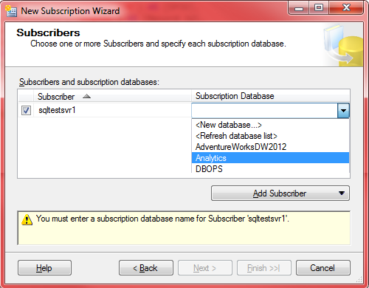
Select Subscriber DB
Simply choose which database the subscription will store its data in:

Slide 31
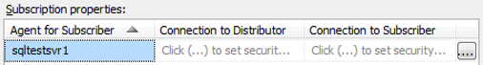
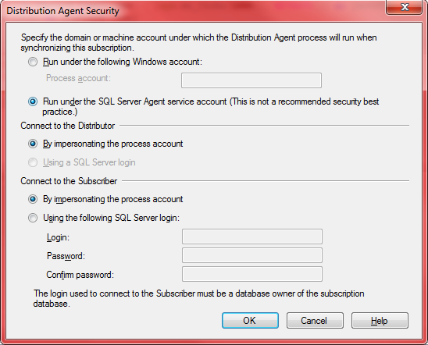
Choose Security Method for Distribution Agent
Based on push or pull model the choices will differ
The Distribution Agent always uses Windows auth (via impersonation) to connect to the local instance where it is located.
Account needs read access to snapshot folder.
Db_owner on subscriber db.
Member of the Publication Access List (PAL)
Notes:
For the connection to the subscription database, you can choose either to use impersonation or to provide a SQL Server login. If all machines are in the same domain, choosing impersonation is a best practice and SQL Server Books Online recommends always using it. However, if you are trying to replicate data between machines that are in separate domains, you might need to go with a SQL Server login.

Slide 32
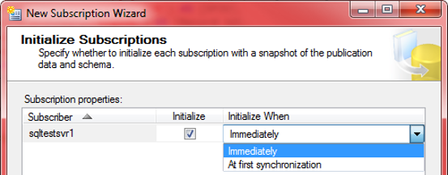
Finally, Choose Initialization Method
Choose the “immediately” option here, unless you want to delay adding subscribers.

Slide 33
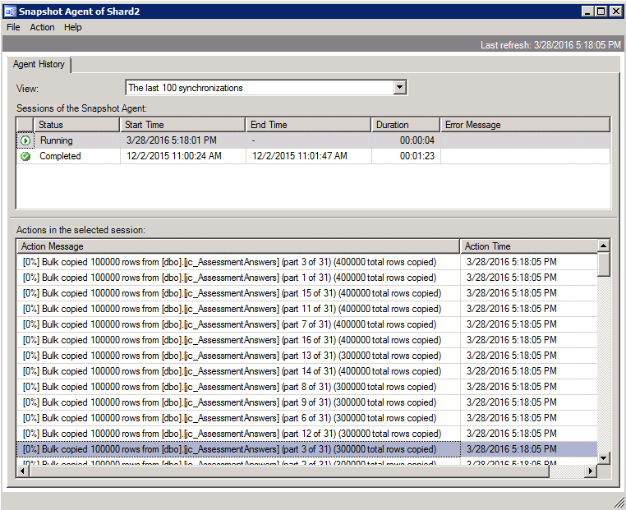
View Progress of Snapshot BCP

Slide 34
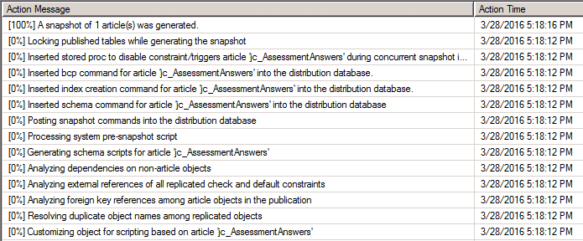
Snapshot All Complete
You look for “A snapshot of # article(s) was generated.”

Slide 35
AlwaysOn Listener Setup
Use Distribution
Go
Exec sys.sp_redirect_publisher
@Original_publisher = 'HQSQL4',
@Publisher_db = 'Limeade',
@Redirected_Publisher = 'HQSQLCluster2';
Exec sys.sp_redirect_publisher
@Original_publisher = 'HQSQL5',
@Publisher_db = 'Limeade',
@Redirected_Publisher = 'HQSQLCluster2';
-- Confirm that the new meta data table has been populated
Select * FROM MSRedirected_Publishers;

Slide 36
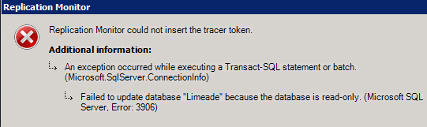
Monitoring Issues With AlwaysOn
AlwaysOn failed over to one of the secondary server’s, you will get this for a TracerToken in ReplMon:
So, use TSQL:
USE SourceDB
--On Publication server
EXEC sys.sp_posttracertoken
@publication = 'PublicationName'
GO
USE Distribution
Go
--publisher_commit
SELECT Top 20 * FROM MStracer_tokens
Order by tracer_id desc
--–subscriber_commit
SELECT Top 20 * FROM MStracer_history
Order by parent_tracer_id DESC
https://blogs.msdn.microsoft.com/repltalk/2010/03/11/divide-and-conquer-transactional-replication-using-tracer-tokens/
Side note: you need to connect to a node name, not listener name when doing anything with replication.

Slide 37
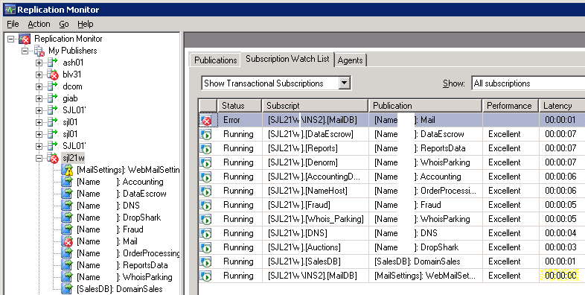
Section 3: Monitoring Replication
ReplMon view of a large replication environment:

Slide 38
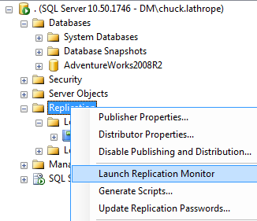
What tool do you use to Monitor?
Launch Replication Monitor from SSMS
From Server Explorer, expand any server, right click Replication and select Launch Replication Monitor
Notes:
It is an exe, so you can create a shortcut to it directly on your computer.

Slide 39
ReplMon Performance Considerations
Replication Monitor can be a performance hindrance.
If you have a large number of publications or subscriptions, consider setting a less frequent automatic refresh schedule.
Avoid concurrently running multiple instances of Replication Monitor.
Avoid registering a large number of Distributors and setting Replication Monitor to automatically connect to all of them.
Notes:
Caching is used heavily by ReplMon. Cache refresh is handled by a SQL Server Agent job, the Replication monitoring refresher for distribution. The job runs continuously, but the cache refresh schedule is based on waiting a certain amount time after the previous refresh.

Slide 40
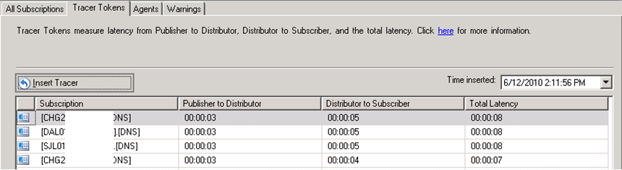
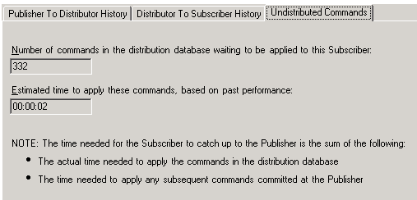
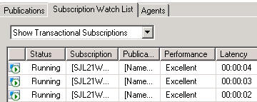
Evaluate Round Trip Latency
Use tracer tokens in ReplMon or TSQL
Or look at Subscriber Latency (full round-trip) or Undist Commands
Notes:
Right click the subscription and select properties to see undistributed commands.

Slide 41
Long Distance Snapshot Delivery
With long distance or slow VPN tunnel
Consider going out through the internet
Control when snapshots occur – don’t let them control you.
Manually zip up data with 7zip application (don’t use SQL snapshot compression).
Deliver one copy to remote location and configure other servers to use that local server share.
Initialize from a backup, instead of snapshot
Initialize from backup including using Log shipping as you can initialize from last log file. See @SQLSoldier presentations on subject.

Slide 42
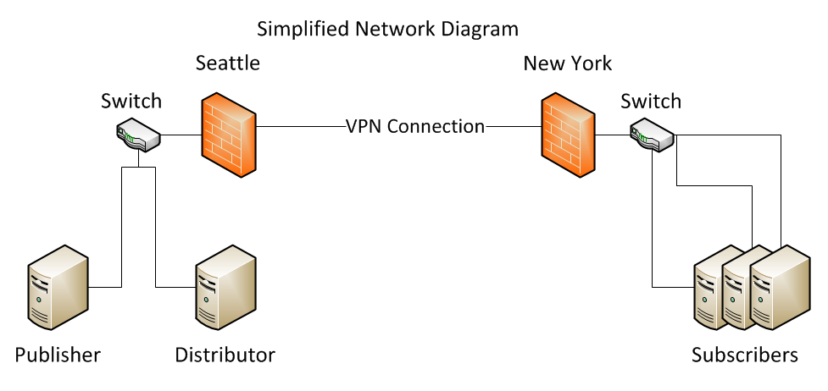
Long Distance Snapshot Delivery Cont.
Robocopy files from distributor to one of the remote subscribers.
Update other remote subscribers to pull from it.

Slide 43
Replmon Word of Warning
Looks like just 1 subscriber in Error
But, there is 00:00:00 Latency on Maildb subscription. Which, in reality has failed but is in retry mode. My custom scripts catch this.

Slide 44
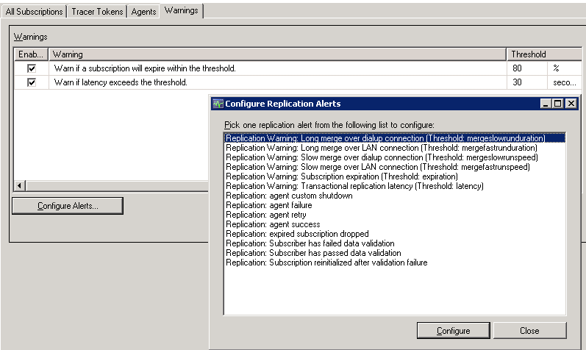
Alerting with SQL Server
In replication monitor, Warnings tab for Publication:
Notes:
These alerts work fine, unless it is in its continuous retry mode, then you are out of luck and it is very chatty.

Slide 45
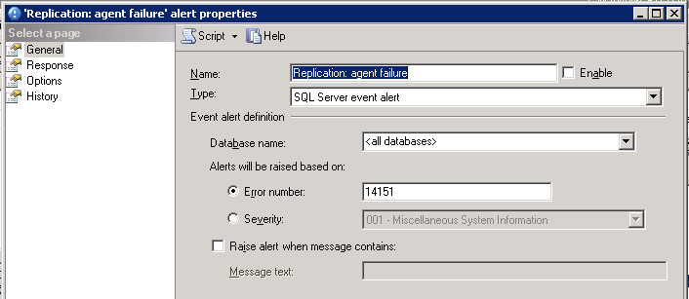
Alerting with SQL Server, cont.
Configuring alert from Replmon pre-populates error number for you.

Slide 46
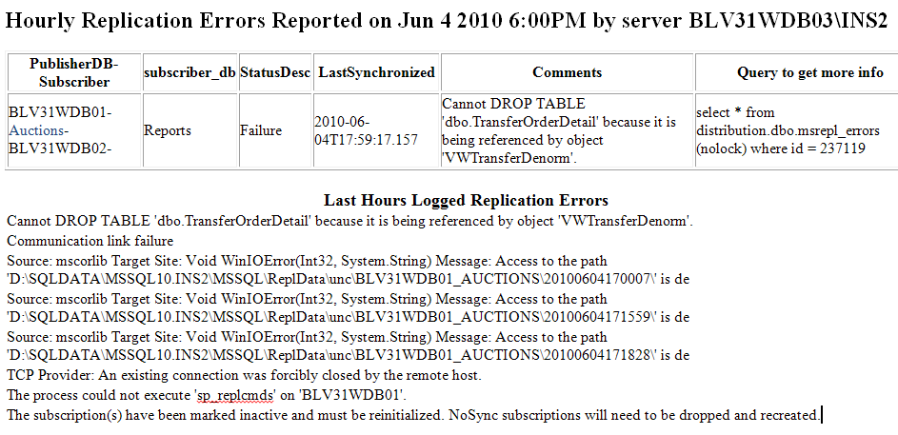
My Custom Error Emails
https://github.com/SQLGuyChuck/SQLReplication

Slide 47
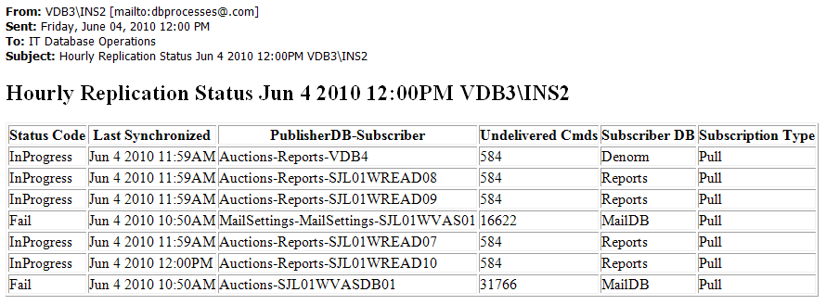
My Hourly Replication Status Email
This is a custom email that shows Status and Undelivered Commands total.

Slide 48
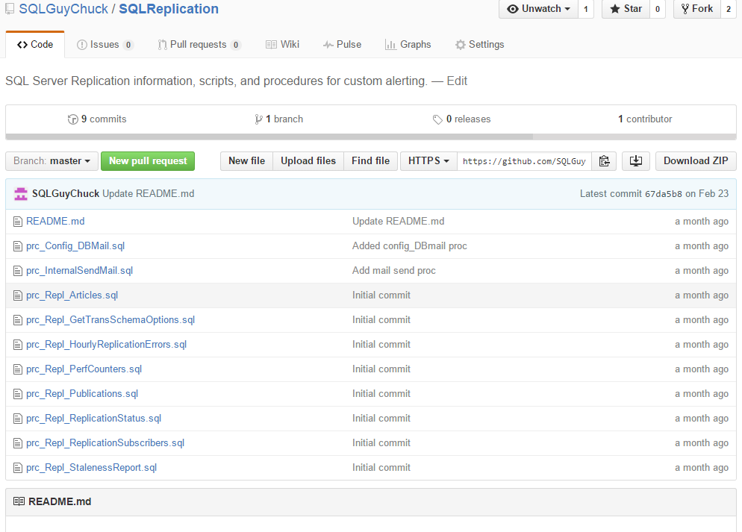
My Code on Github

Slide 49
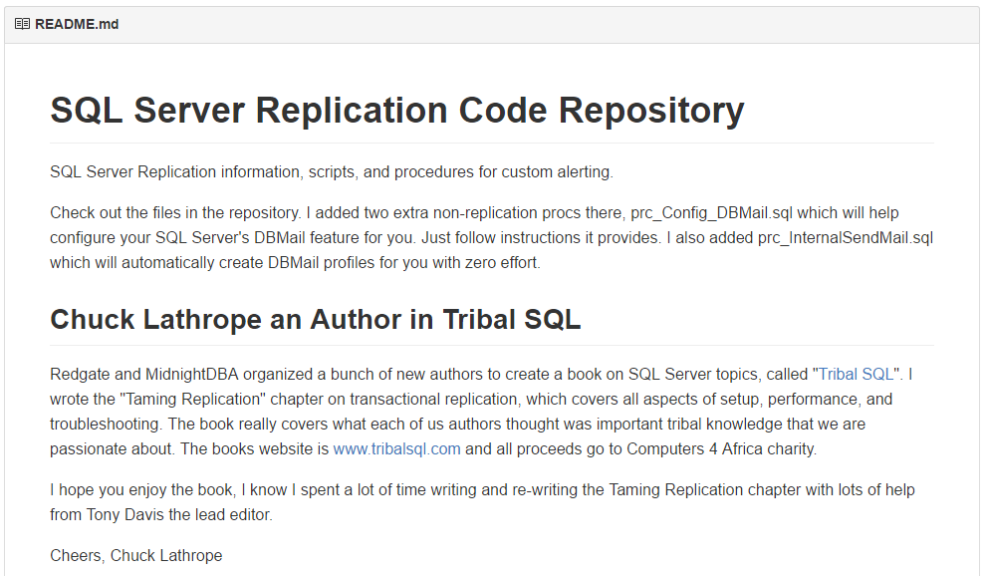
Readme.md wiki page on Github

Slide 50

Section 4:Performance Tuning

Slide 51
Server Configuration Tips
Use a dedicated Distribution server
If on Windows 2003 make sure your disks are aligned with diskpart when you create partition.
Format disk with 64KB allocation unit size (cluster size). Default is 4KB.
RAID 10 if you can afford it.
Published database’s LOG file needs fast disk!
Service account should have Perform Volume Maintenance Tasks Local Security Policy right.
Pre-create your DB in optimized manner
Watch out for high VLF’s. Kimberly Tripp has great advice here: http://bit.ly/1cuUtre

Slide 52
Distributor and Subscribers
The Distributor collects data changes by reading the log file and storing changes in Distribution database.
Performance Tip: Millions of transactions – attempt to use multiple distribution databases.
Subscribers receive data and can Pull the data down or data can be Pushed.
Performance Tip: Many subscribers => use Pull.
Performance Tip: Use customized Agent Profiles and increase batch sizes by 10X and test/monitor
Subscribers are initialized by taking snapshots of publication data or less commonly db backups.

Slide 53
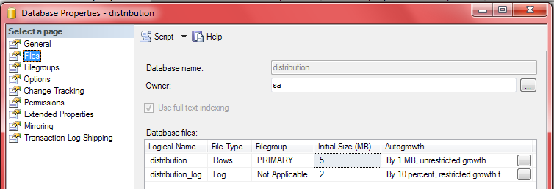
Database File Optimizations
Don’t forget that default values for new databases are sub-optimal.
I recommend 4 data files, 1 log file. Size all data files the same, give 1 year’s worth of empty space, growth size should be large for data and not percentage. Log growth of 300-500MB.

Slide 54
Replication Config Recommendations
With many subscriptions, use Pull Subscriptions
Keep snapshot folder away from DB files (4KB cluster).
Run agents continuously instead of infrequent schedules.
Potentially use –SubscriptionStreams option on Dist Agent or create many publications (parallel threads)
Minimize use and complexity of publication filters
Use Custom Agent Profiles

Slide 55
Create Agent Profiles
You can create a profile for each of these agents:
Replication Snapshot Agent
Replication Log Reader Agent
Replication Distribution Agent
Replication Merge Agent
Create multiple and tailor to your infrastructure

Slide 56
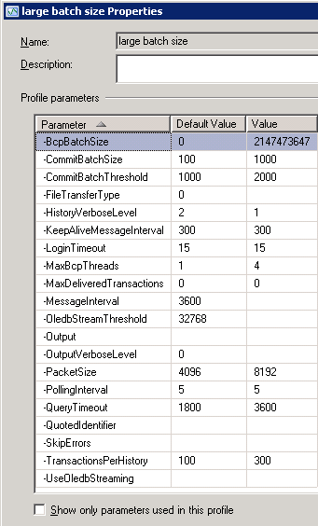
Custom Agent Profiles
Create a new Replication Profile in Replication Monitor by right clicking a subscriber and select Agent Profile, copy the default one and modify it; uncheck the Show only parameters used in this profile checkbox and tweak and test values.

Slide 57
Agent Properties to Change
CommitBatchSize - 1000 (approx max number of batches)
CommitBatchThreshhold - 2000 (approx max total commands for all batches - definitely test)
HistoryVerboseLevel – 1
MaxBCPThreads - 4 (Nothing to do with ongoing operations, just when you create a snapshot it won't be single threaded.)
TransactionsPerHistory - 1000 (Just limits amount of updates you get in Repl Monitor, tweak to your comfort level)
QueryTimeout – 4000
PacketSize - 12288 (This is on a good network. Adjust in 4096 increments +/- until SQL Agent Job doesn't crash - Pre SQL 2005 SP3 there is a bug with large packet sizes.)

Slide 58
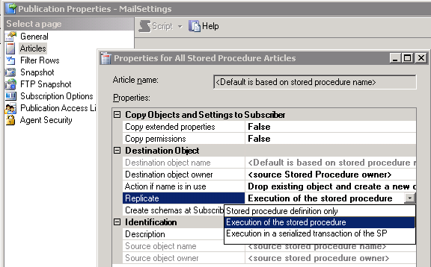
Large Data Change Performance Tips
Change to using stored procedures to update/delete many rows at subscriber(s). Default is definition only.
Notes:
http://msdn.microsoft.com/en-us/library/ms152754(SQL.90).aspx

Slide 59
Takeaway Points
Replication is fairly easy to setup and maintain
Understand your network
Use a dedicated distributor
Optimize your data files
Test your custom Agent Profile config options
Don’t rely on visually watching Replication Monitor for error monitoring.
Minimize use of filters on publications.
Control subscription snapshots over WAN.

Slide 60

Bonus 1: Troubleshooting Replication
Photo credit: https://www.flickr.com/photos/keoni101/7221666136

Slide 61
TSQL to View Errors
This error logging table is good start, but may not have all issues, so do check msrepl_errors table.
select top 10 * from msdb.dbo.sysreplicationalerts order by alert_id desc
Typically, I jump right to Msrepl_errors table for recent period of time:
select top 300 * from distribution.dbo.MSrepl_errors WITH (NOLOCKI) where time > getdate() - .05 -- defaults to .05 of a day order by time desc
Get the xact_seqno value and command_id value
exec sp_browsereplcmds @xact_seqno_start = '0x00000DDC0003B16D000600000000', @xact_seqno_end = '0x00000DDC0003B16D000600000000‘
Result: {CALL [sp_MSupd_dboOrders] (,,,,,,,,,,,,8,,14318718,0x0010)}
It is doing an update for Orders with OrderID 14318718

Slide 62
Event Viewer Errors
Date 6/4/2010 4:52:23 PM
Log SQL Server (Current - 6/4/2010 4:32:00 PM)
Source spid52
Message
Error: 14151, Severity: 18, State: 1.
Message:
Replication-Replication Distribution Subsystem: agent BLVWDB03-Orders-Orders-BLVWDB02-62 failed. The subscription(s) have been marked inactive and must be reinitialized. NoSync subscriptions will need to be dropped and recreated.

Slide 63
Skip a Transaction Row
Exec sp_setsubscriptionxactseqno @publisher='vdb1',@publisher_db ='AdvWorks',@publication = 'Orders',@xact_seqno=0x0015731B0002331C
use Reports; --must be active at the subscriber.
exec sp_setsubscriptionxactseqno @publisher='vdb1',@publisher_db ='AdvWorks',@publication = 'Orders', @xact_seqno=0x0015731B0002331C
ORIGINAL XACT_SEQNO UPDATED XACT_SEQNO SUBSCRIPTION STREAM COUNT
0x0015731B000233150028000 0x0015731B0002331C0001 1
Have to restart the distribution agent job for it to work
If you are not active in subscriber DB, you will see this error:
Msg 20017, Level 16, State 1, Procedure sp_setsubscriptionxactseqno, Line 69
The subscription on the Subscriber does not exist.
Credit: http://blogs.msdn.com/chrissk/archive/2009/09/08/how-to-skip-a-transaction-in-sql-2005-2008-transactional-replication.aspx

Slide 64
If this happens to you
Missing Objects
“Could not find stored procedure spMSins_...”
Solution:
Use sp_scriptpublicationcustomprocs to generate stored procedures for publication

Slide 65
Add Verbose Output to Agent Job
Refer to http://support.microsoft.com/kb/q312292
Says append these parameters to replication "Run agent" job step.
-Output C:\ReplOutput.txt -OutputVerboseLevel 2
-Publisher [VDB1] -PublisherDB [Orders] -Distributor [VDB3\INS2] -DistributorSecurityMode 1 -Continuous -Output C:\ReplOutput.txt -OutputVerboseLevel 2

Slide 66
Ansi_padding Compatibility
The source and destination databases need compatible Ansi_padding settings.
BOL states the best practice is to have it on.
Error message you will see if different:
CONDITIONAL failed because the following SET options have incorrect settings: 'ANSI_PADDING'. Verify that SET options are correct for use with indexed views and/or indexes on computed columns and/or filtered indexes and/or query notifications and/or XML data type methods and/or spatial index operations.
To fix, manually modify the script files in snapshot folder, or find a way to make them the same.

Slide 67
Bonus #2 How to do code deployments
Say you want to make a schema change to one table on large publication and it wants to create a full snapshot.
First, cancel your change and run snapshot agent by itself to clear out any ghosts.
Try change again, if it still wants to create full snapshot, try dropping table from publication and re-adding it.
If you are load balancing subscribers, stop the distribution agent job on all and work one at a time.

Slide 68
Useful Links and Used References
SQL Server Replication Latency Monitoring Tool from MSIT: http://bit.ly/1kkBM04
MS IT Transactional SQL Replication Best Practices Using SQL Server: http://bit.ly/KuaJjf
http://blogs.msdn.com/b/repltalk
Enhancing Transactional Replication Performance http://msdn.microsoft.com/en-us/library/ms151762.aspx
Publishing Stored Procedure Execution in Tran Replication http://msdn.microsoft.com/en-us/library/ms152754(SQL.90).aspx

Slide 69
Thanks for Attending!
Chuck Lathrope (@SQLGuyChuck
Email: sqlguychuck@gmail.com
Code: https://github.com/SQLGuyChuck
http://www.sqlsaturday.com/511/sessions/sessionevaluation.aspx

